Slide 1

A Journey Through Azure Serverless Series Building Stateful Serverless Applications Using Azure Durable Entities 28 April, 12pm CEST

Slide 2
Our Code of Conduct
Be welcoming and respectful
Be open to all questions and viewpoints
Be understanding of differences
Be kind and considerate to others
Be aware of others
Be friendly and patient
Microsoft is dedicated to empowering every person and every organization on the planet to achieve more. This includes Microsoft Reactor events where we seek to provide a respectful, friendly, professional experience for everyone, regardless of gender, sexual orientation, physical appearance, disability, age, race or religion. We do not tolerate any behaviour that is harassing or degrading to any individual, in any form. Individuals are responsible for knowing and abiding by these standards. We encourage everyone to assist in creating a welcoming and safe environment.

Slide 3

Speaker info
Eldert Grootenboer
Azure MVP and Technology Lead
Eldert can be described as an Azure MVP, Technology Lead, Cloud Solution Architect, blogger, public speaker and technical author. He can regularly be seen on conferences and user groups, speaking on Cloud related topics, with a strong focus on Azure. His experience with the Cloud comes from his daily work with these technologies in many innovative projects with various clients, as well as his drive to further dive into the latest developments in his spare time. Eldert enjoys sharing his knowledge with the community, and believes this is the best way to each other obtain more and better opportunities.

Slide 4
About the series
7/4
An Introduction to Azure Serverless
14/4
Azure's Integration Platform: Building Serverless Applications
21/4
Azure’s Data Platform: Building Serverless Applications
28/4
Building Stateful Serverless Applications Using Azure Durable Entities

Slide 5
Building Stateful Serverless Applications Using Azure Durable Entities

Slide 6



Eldert Grootenboer
@egrootenboer

Slide 7
Azure Functions

Slide 8



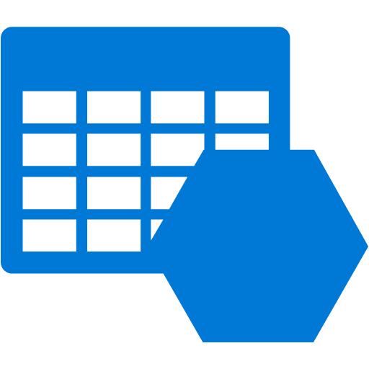





Azure Functions
Events
Code
Outputs
Notes:
20

Slide 9
Azure Durable Functions

Slide 10
Azure Durable Functions
Extension on Function
Create workflows
Built on Durable Task Framework

Slide 11
Function Types
Client (stateless)
Orchestrator
Activity
Entity

Slide 12
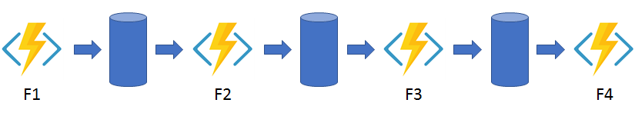
Pattern: Function chaining
Notes:
In the function chaining pattern, a sequence of functions executes in a specific order. In this pattern, the output of one function is applied to the input of another function.

Slide 13
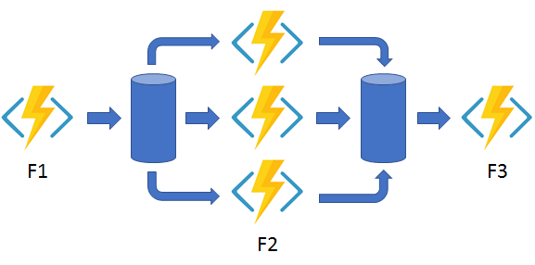
Pattern: Fan out/fan in
Notes:
In the fan out/fan in pattern, you execute multiple functions in parallel and then wait for all functions to finish. Often, some aggregation work is done on the results that are returned from the functions.

Slide 14
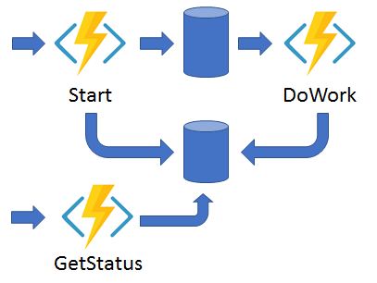
Pattern: Async HTTP APIs
Notes:
The async HTTP API pattern addresses the problem of coordinating the state of long-running operations with external clients. A common way to implement this pattern is by having an HTTP endpoint trigger the long-running action. Then, redirect the client to a status endpoint that the client polls to learn when the operation is finished.

Slide 15
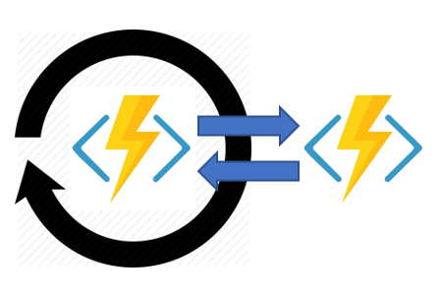
Pattern: Monitor
Notes:
The monitor pattern refers to a flexible, recurring process in a workflow. An example is polling until specific conditions are met. You can use a regular timer trigger to address a basic scenario, such as a periodic cleanup job, but its interval is static and managing instance lifetimes becomes complex. You can use Durable Functions to create flexible recurrence intervals, manage task lifetimes, and create multiple monitor processes from a single orchestration.

Slide 16
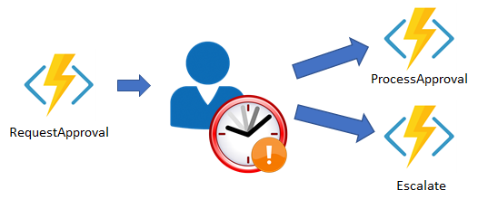
Pattern: Human interaction
Notes:
Many automated processes involve some kind of human interaction. Involving humans in an automated process is tricky because people aren't as highly available and as responsive as cloud services. An automated process might allow for this interaction by using timeouts and compensation logic.

Slide 17

Demo

Slide 18
Azure Durable Entities

Slide 19
Actor Model
Addressable by ID
State machine
Communicates through async messages
Lightweight
Never shares state / no global state
Processes one message at a time, in order
Is a single thread object
Notes:
The actor model in computer science is a mathematical model of concurrent computation that treats actor as the universal primitive of concurrent computation. In response to a message it receives, an actor can: make local decisions, create more actors, send more messages, and determine how to respond to the next message received. Actors may modify their own private state, but can only affect each other indirectly through messaging (removing the need for lock-based synchronization).

Slide 20
Durable Entities
Manage state
Operation execute serially
Unloaded when not executed
Actor model

Slide 21
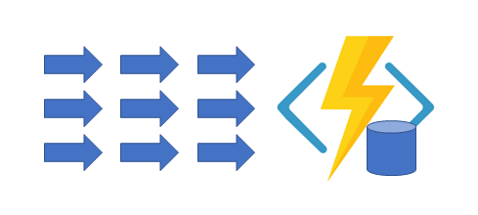
Pattern: Aggregator
Notes:
The sixth pattern is about aggregating event data over a period of time into a single, addressable entity. In this pattern, the data being aggregated may come from multiple sources, may be delivered in batches, or may be scattered over long-periods of time. The aggregator might need to take action on event data as it arrives, and external clients may need to query the aggregated data

Slide 22
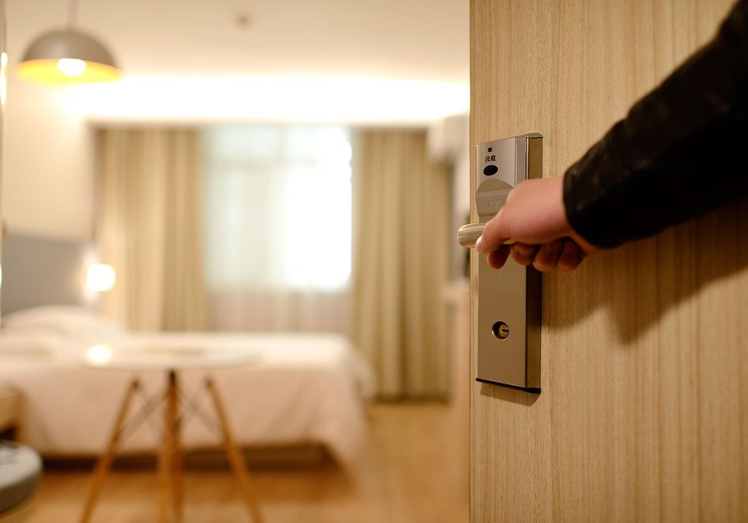
Demo
keesschollaart81/Serverless-Actors-With-Durable-Entities: Serverless Actors With Durable Entities (github.com)
Notes:
When looking for scenario, found demo which perfectly describes my case, don’t re-invent the wheel
Model defined function

Slide 23
Almost done…

Slide 24
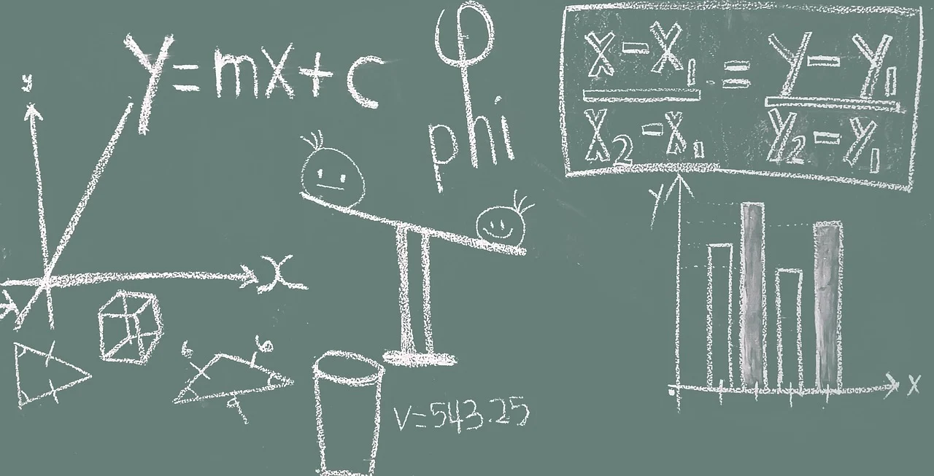
Key Takeaways
Stateful
Use Durable Functions & Entities
Scalable
Highly scalable without needing to think about plumbing
Better Together
Combine the various types of Functions for more capabilities

Slide 25
For more learning on this topic, visit Learn TV on https://aka.ms/CreateServerlessApps-12 https://aka.ms/AzureSynapseAnalytics-12 https://aka.ms/BuildDataAnalytics-12 https://aka.ms/ArchitectMessageBroker-12
Survey Link: https://aka.ms/Reactor/Survey
Please enter the event code 13120 at the start of survey

Slide 26

Join our community
meetup.com/Microsoft-Reactor-Stockholm/
@MSFTReactor
Microsoft Reactor at Epicenter,
Master Samuelsgatan 36, 5th floor,
111 57 Stockholm Sweden
Questions? ReactorStockholm@microsoft.com
http://www.youtube.com/c/MicrosoftReactor
ReactorStockholm@microsoft.com

Slide 27




Thank You!
@egrootenboer
eldert@eldert.net
https://www.linkedin.com/in/eldert-grootenboer
Notes:
Rustig spreken!

